Slide 1
Structure of Presentation
Introduce traditional RPGs/DnD -> show how we will incorporate AI into this
Need a human DM -> AI language model;
Visualise using imagination -> AI image model;
Choose from a set of options -> Type anything you want
Railroaded into few story lines -> infinite story possibilities
Video demo of project
Mention Technologies used
Models; Loras; ComfyUI
LLM stuff

Slide 2
Structure of Live Presentation
(15s)Introduce traditional RPGs/DnD -> show how we will incorporate AI into this
Need a human DM -> AI language model;
Visualise using imagination -> AI image model;
Choose from a set of options -> Type anything you want
Railroaded into few story lines -> infinite story possibilities
(15s)Mention Technologies used
Models; Loras; ComfyUI
LLM stuff
Video demo of project

Slide 3
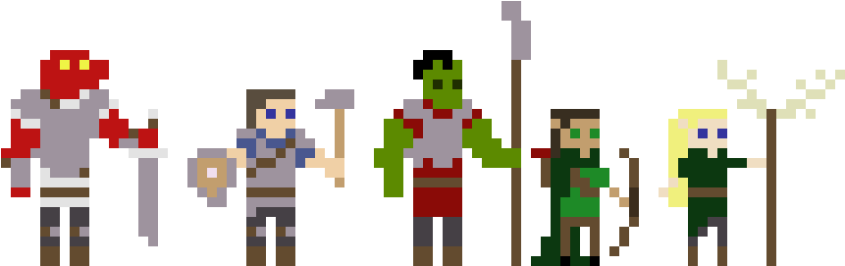
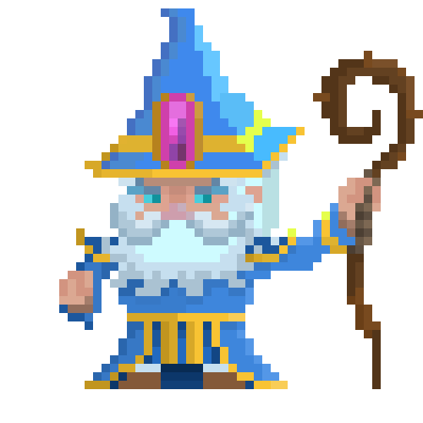
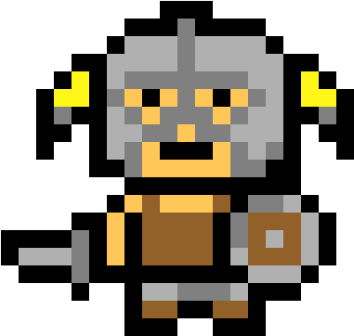
AI Dungeons and Dragons
Artificial Intelligence Generated Content
TechFest 2024 - Team 118
Notes:
From the spells of Harry Potter to the quests of Lord of the Rings, stories captivate us, and we yearn to be part of them.

Slide 4
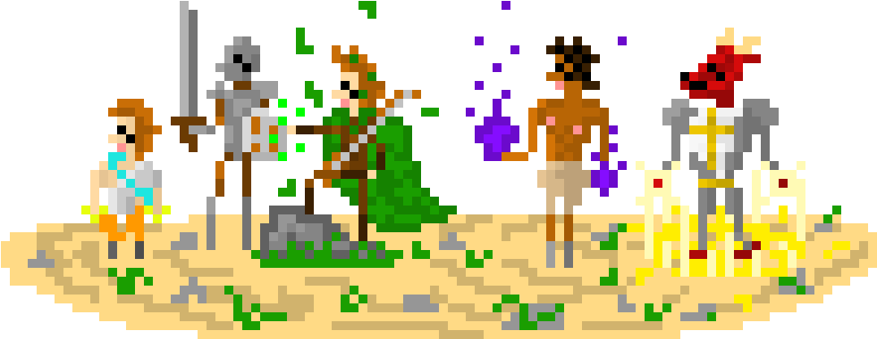
ADnD
AI Dungeons and Dragons
Artificial Intelligence Generated Content
TechFest 2024 - Team 118

Slide 5
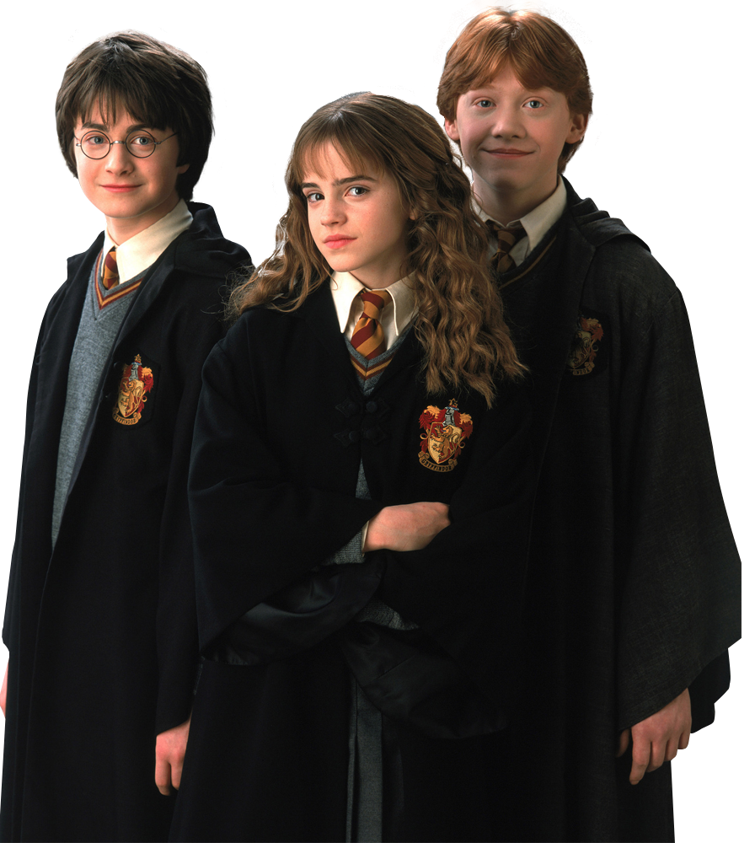
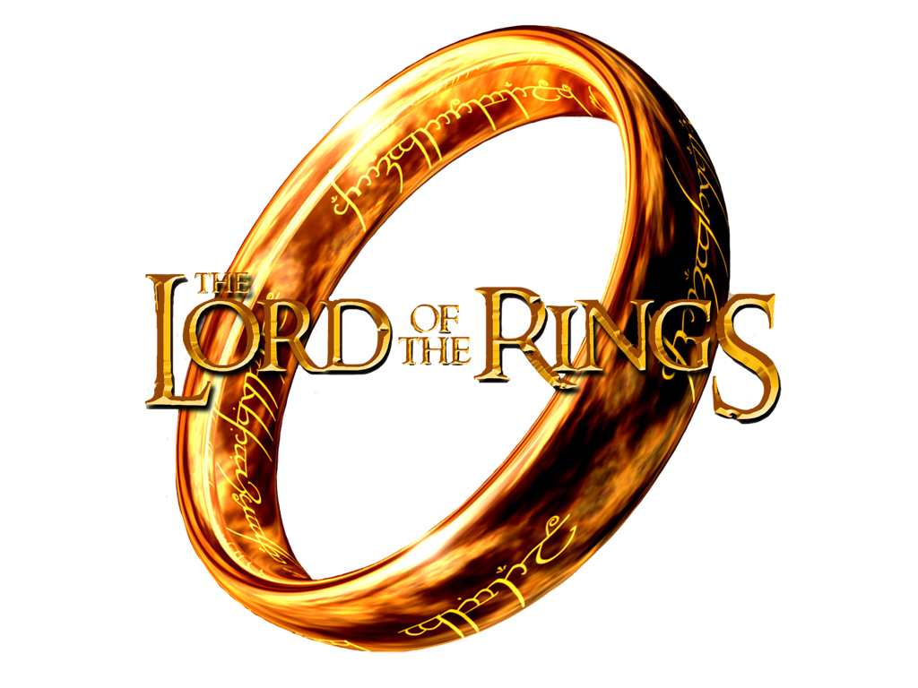
Notes:
From the spells of Harry Potter to the quests of Lord of the Rings, stories captivate us, and we yearn to be part of them.

Slide 6
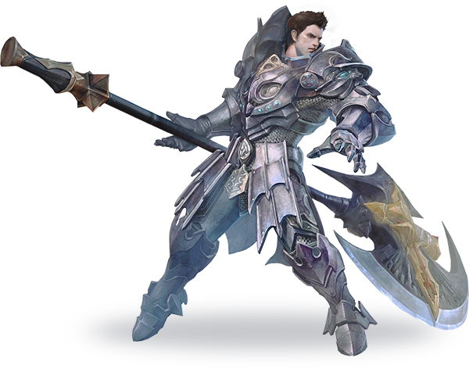
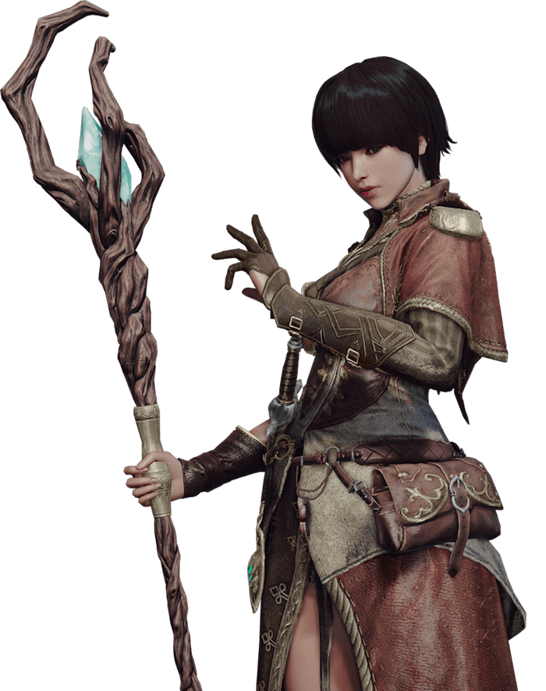
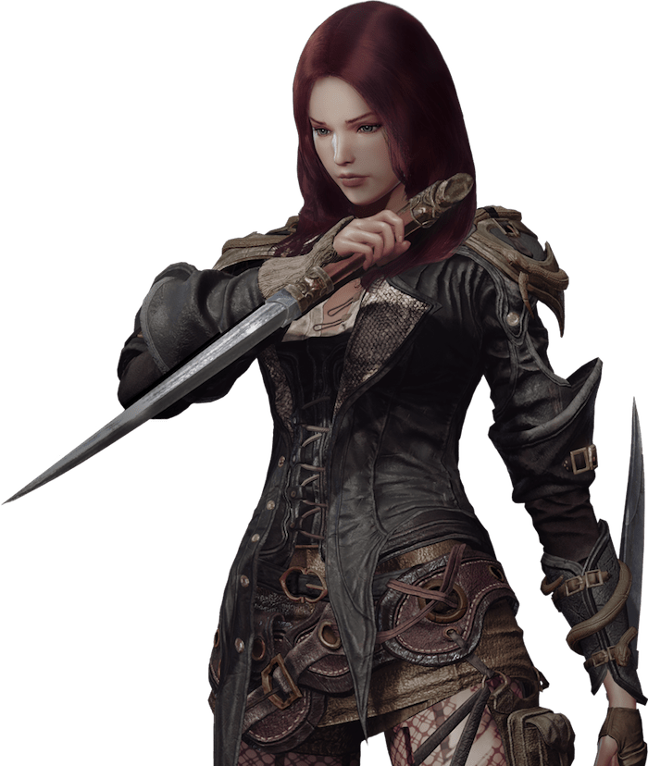
Role Playing Games and Dungeons & Dragons
Pre-set actions, storylines, endings
Human dungeon master
Must use Imagination
Bad experience with wrong people
Notes:
Role-Playing Games like Dungeons and Dragons transport us there, but with limitations — preset plots and the need for imagination, sometimes bad teammates
People have always loved making stories and imagining make-believe worlds. Today we have Role-Playing Videogames and Dungeons and Dragons; and let me show you how we plan to enhance these using AI. Where traditional RPGs only allow the player to choose from a handful of options, and there are only a few storylines; with AI the player can type in anything, allowing an infinite number of possibilities for what the player can do or say, and how the story can resolve. Where DnD requires players to make use of their imagination; we can replace that with an image generation model. Lastly, we can have an AI language model to take the role of dungeon master.

Slide 7
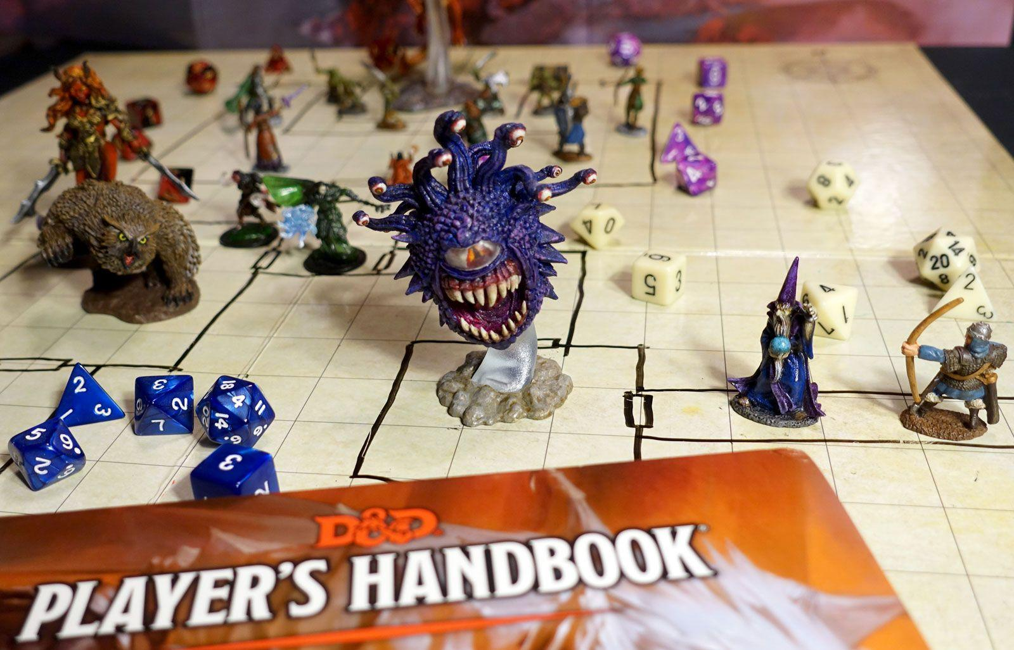
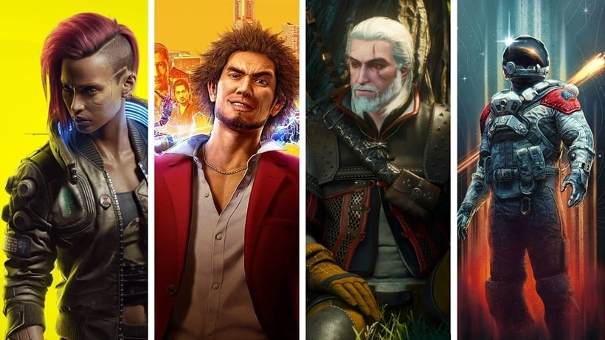
Role Playing Games and Dungeons & Dragons
Pre-set actions, storylines, endings
Human dungeon master
Must use Imagination
Bad experience with wrong people
Notes:
Role-Playing Games like Dungeons and Dragons transport us there, but with limitations — preset plots and the need for imagination, sometimes bad teammates
People have always loved making stories and imagining make-believe worlds. Today we have Role-Playing Videogames and Dungeons and Dragons; and let me show you how we plan to enhance these using AI. Where traditional RPGs only allow the player to choose from a handful of options, and there are only a few storylines; with AI the player can type in anything, allowing an infinite number of possibilities for what the player can do or say, and how the story can resolve. Where DnD requires players to make use of their imagination; we can replace that with an image generation model. Lastly, we can have an AI language model to take the role of dungeon master.

Slide 8

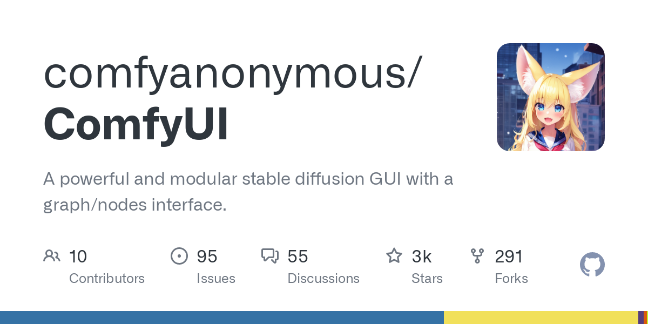
AI Dungeons and Dragons
Type anything, Infinite possibilities
AI language model → dungeon master
AI image generation model → scenes
Play Solo, Anytime, Anywhere
Notes:
Today, we break these chains with AI, offering infinite possibilities where you can type anything and let an AI dungeon master and image model craft your unique adventure. Play solo, anytime, anywhere — this is the new era of RPGs.
People have always loved making stories and imagining make-believe worlds. Today we have Role-Playing Videogames and Dungeons and Dragons; and let me show you how we plan to enhance these using AI. Where traditional RPGs only allow the player to choose from a handful of options, and there are only a few storylines; with AI the player can type in anything, allowing an infinite number of possibilities for what the player can do or say, and how the story can resolve. Where DnD requires players to make use of their imagination; we can replace that with an image generation model. Lastly, we can have an AI language model to take the role of dungeon master.

Slide 9
US$44.95bn
2022
US$70.73bn
2027
Notes:
In an RPG market soaring to $70.73 billion by 2027, the sky's the limit for ADnD

Slide 10
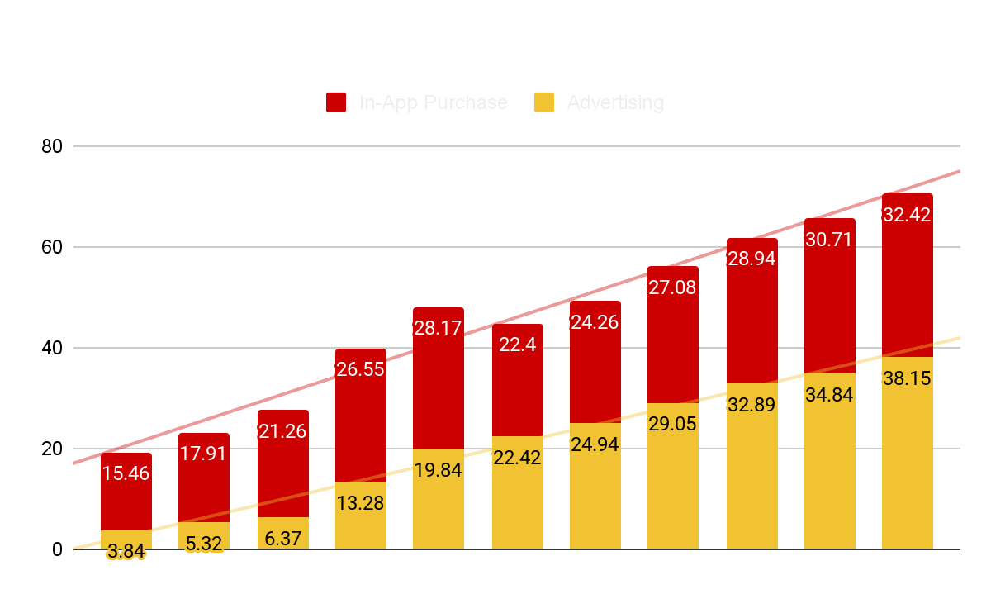
Role Playing Game Market Projection
USD
70.73
bn
2027
Notes:
In an RPG market soaring to 70+ billion USD by 2027, the sky's the limit for ADnD

Slide 11
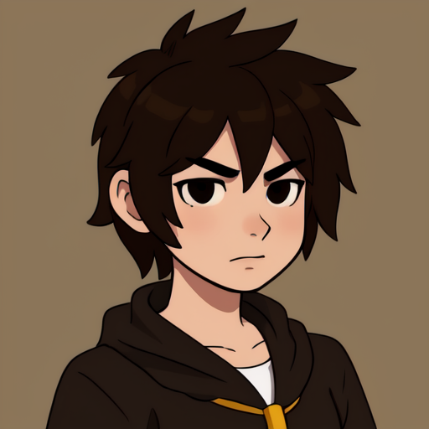
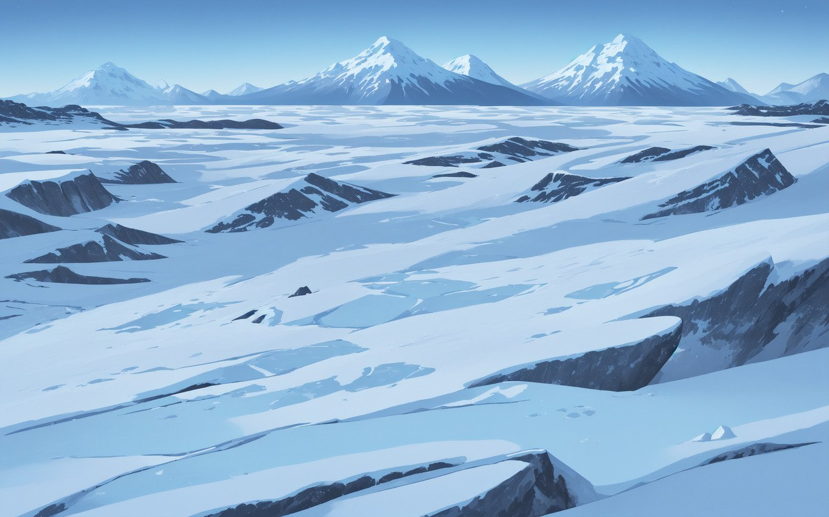
Technical Details
Language Model (LLaMa 2)
Prompt engineering (fine tune)
Dynamic
Generation of backgrounds and character portraits
Image Generation Model (ComfyUi +StableDiffusion + LoRAs)
Used different LoRAs to generate same portraits with different expressions
Simple Sentiment Analysis Model
Live
Interaction between users and models
classifies dialogues into different expressions
Seamless
Serving of images using API to GUI
GUI (Silly Tavern)
Modified to handle images

Slide 12
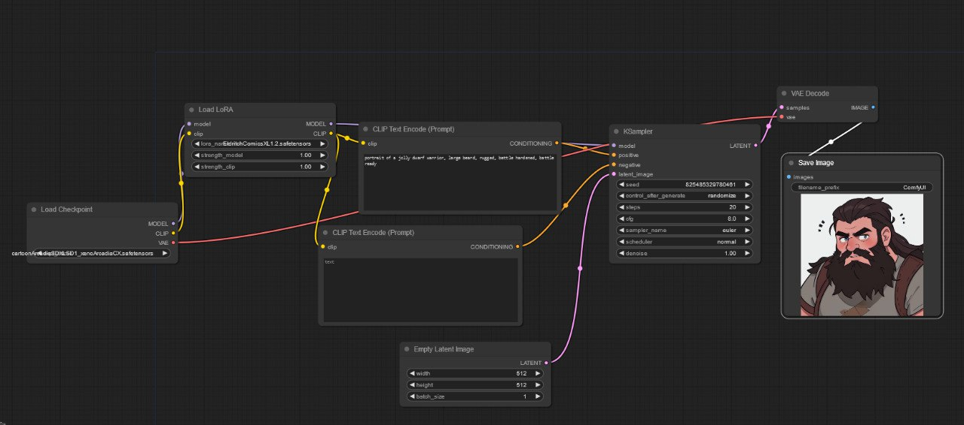
ComfyUI

Slide 13
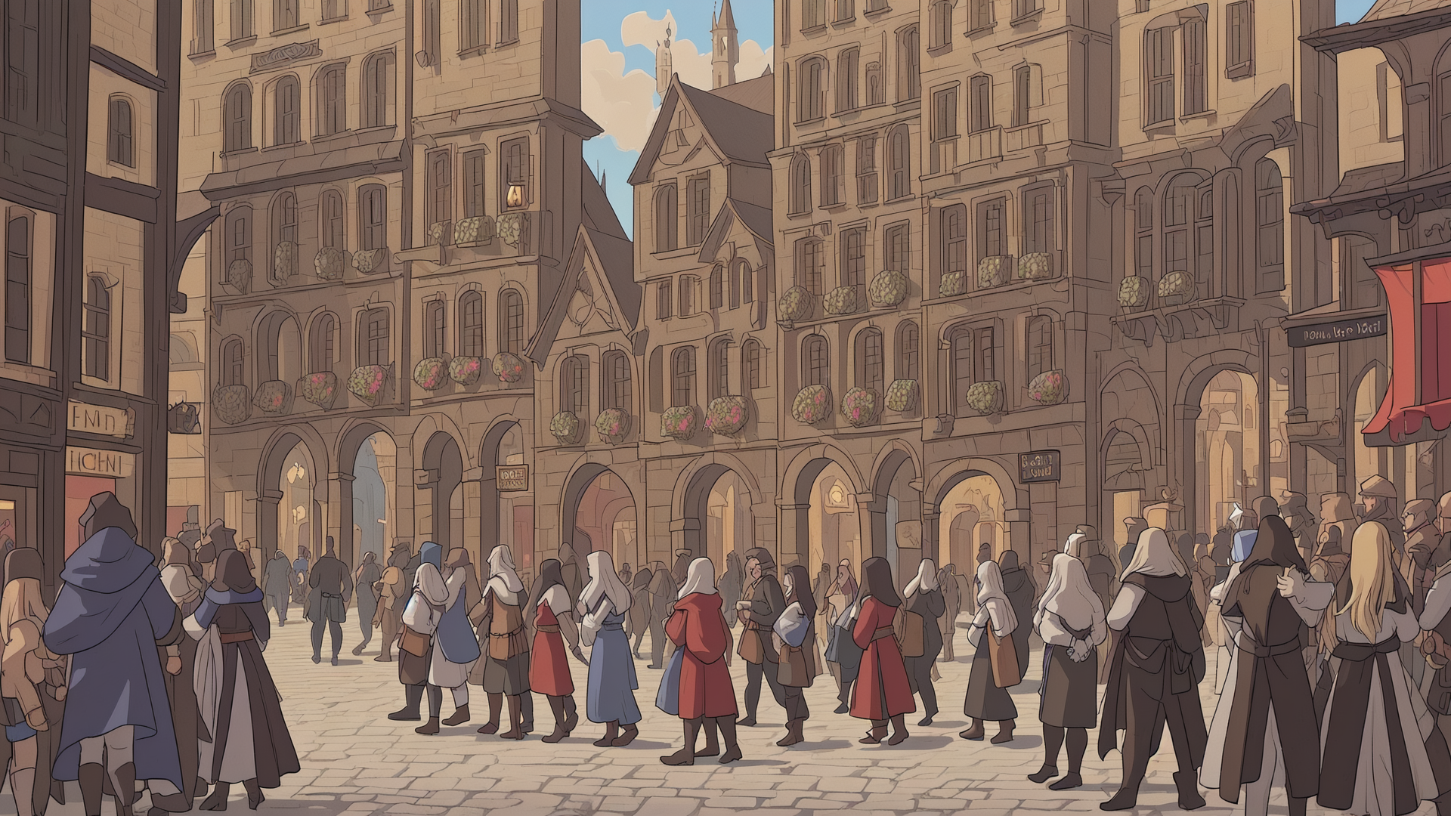
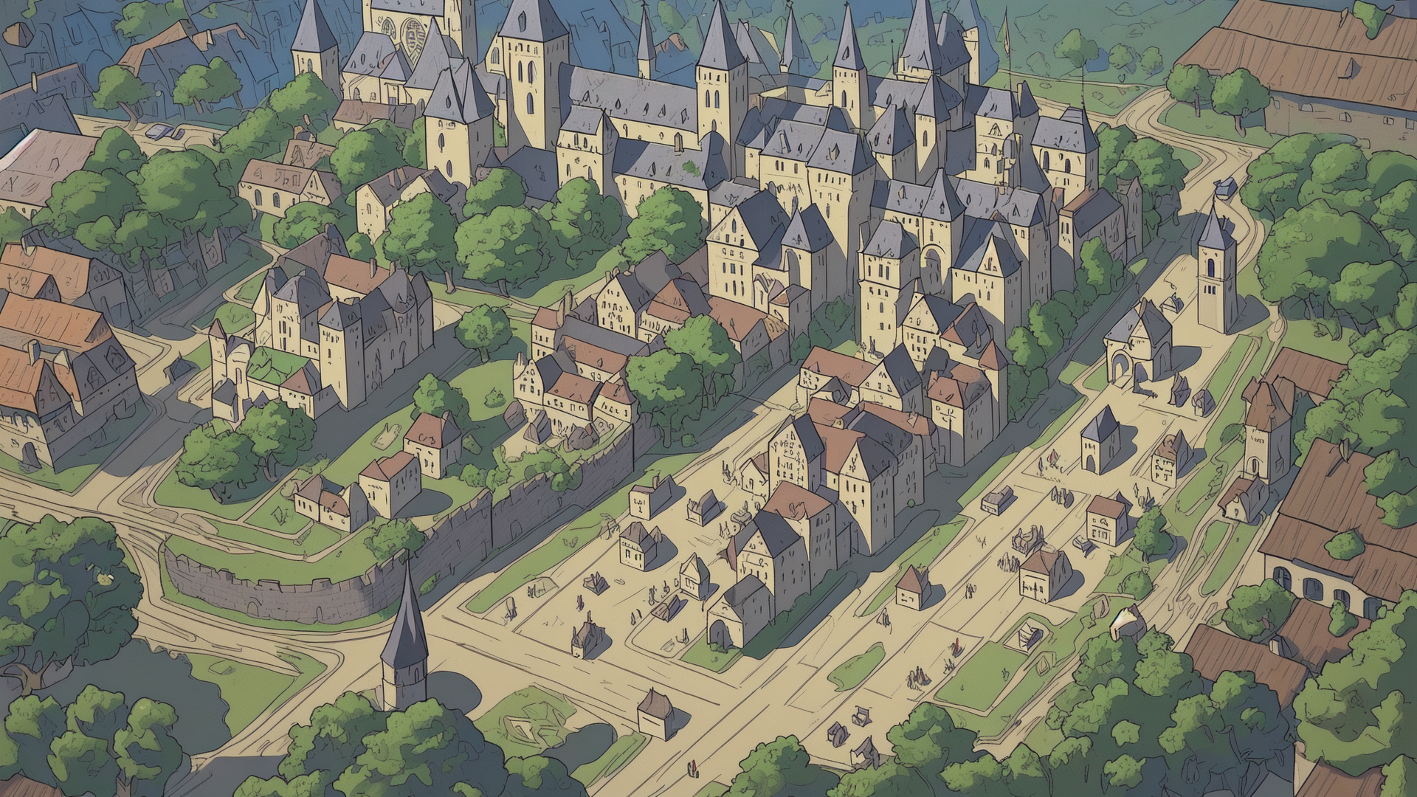
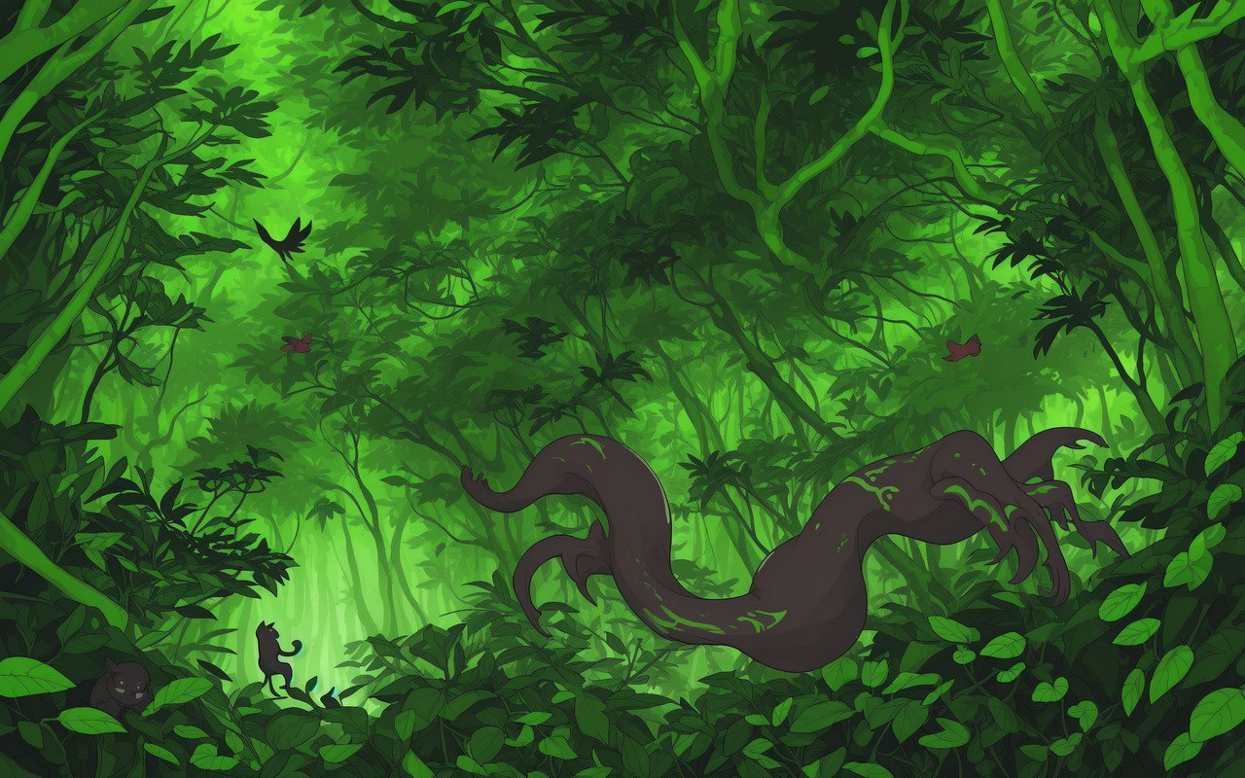

Image generation
Notes:
The image generation is done using ComfyUI and stable diffusion. The model generates backgrounds for different scenes and character portraits based on descriptions provided by the language model. We also generate 6 portraits for each character, for various emotions. This is done using LoRAs to change the expression, but the seed is kept the same so the generated images are as similar as possible.

Slide 14
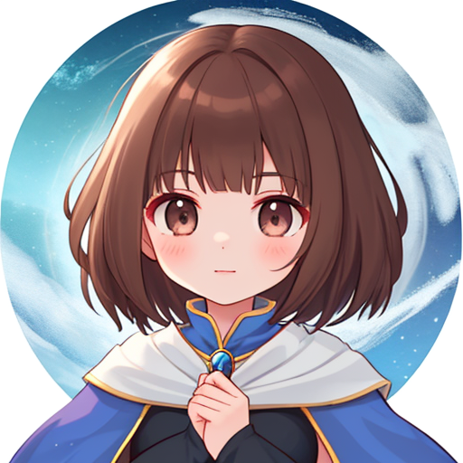
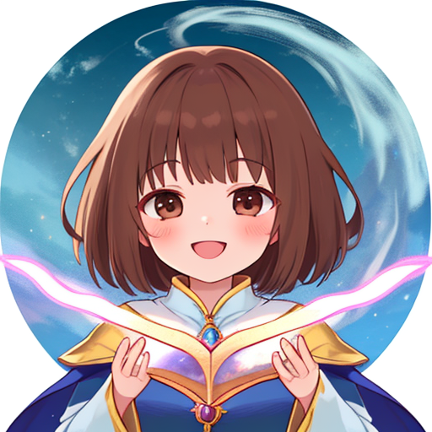

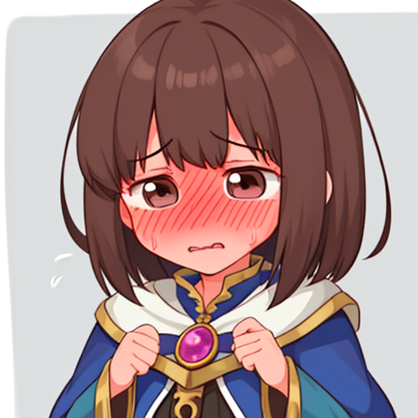


Image generation
6 different emotions for a character using LoRAs.
Seed is same so images come out similar.
Notes:
The image generation is done using ComfyUI and stable diffusion. The model generates backgrounds for different scenes and character portraits based on descriptions provided by the language model. We also generate 6 portraits for each character, for various emotions. This is done using LoRAs to change the expression, but the seed is kept the same so the generated images are as similar as possible.

Slide 15
Technical Details
Prompts the image model to generate images dynamically
NOT DEMOED TODAY - Hardware Limitations
Image Generation Model (Stable Diffusion + LoRAs)
Used different LoRAs to generate same portraits with different expressions
Language Model (LLaMa 2)
Prompt engineering (fine tune)
Simple Sentiment Analysis Model
FULLY DEMOED
Text is sent between LM and GUI
FULLY DEMOED
classifies dialogues into different expressions
FULLY DEMOED
Images are served via API to the GUI
GUI (Silly Tavern)
Modified to handle images

Slide 16
<Demo>

Slide 17
<Questions?>

Slide 18
Future Development Avenues
Speech-to-text for playing the game
AI voice-over of character dialogues
AI generated ambient sounds and sound effects
Multiplayer functionality, where multiple human players can play with AI
Integration with popular fictional universes - set in universes like Harry Potter, Game of Thrones, Lord of the Rings, Star Wars

Slide 19
Difficulties
Hardware compatibility
API Response
Bridging Text & Image Generation Models

